Slide 1
How to become a Googler?!
NYC Data Science BootCamp
R Shiny Project
SangYeon Choi

Slide 2

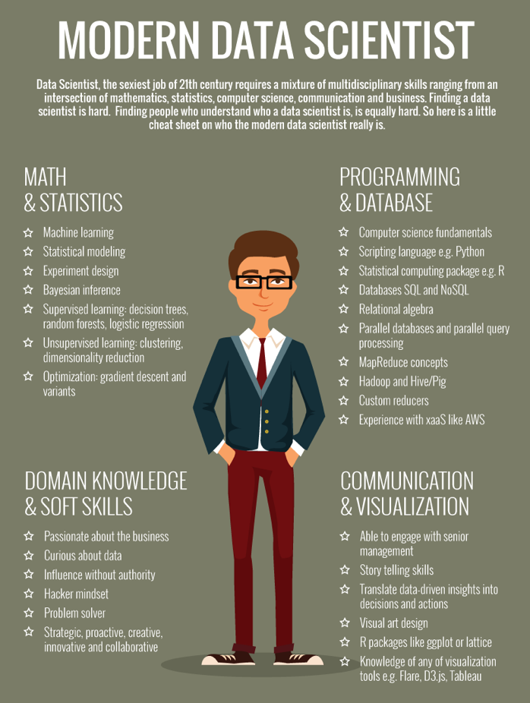
Why we are here?
- Why do we study data science here?
- There are different reasons, but the greatest goal is to get a job as a Data Scientist.
For Job?
- To-do list
1. Skill up! – Ability of Data Science
2. Interview Skill
3. Network
4. Find Job opportunity

Slide 3
Yes! We Know
- Data Scientist is a prospective job
- Since interest in Big Data has increased, There is demand in all areas.
<Data Scientist Job demand Trend >

Slide 4
What skills should I have? Which company can I join?
OK! Let’s find out from data!

Slide 5
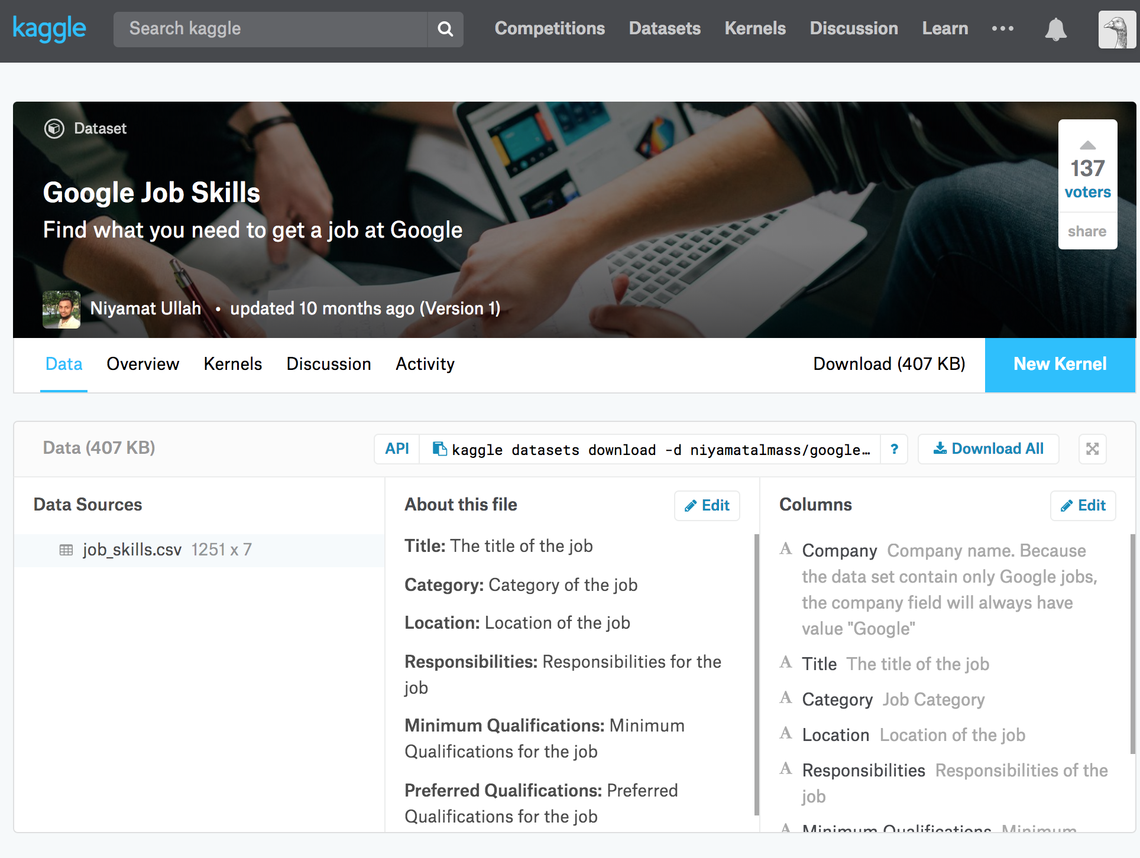
Data From Kaggle
Kaggle Data sets
: google-job-skills
Features
: 7 feature
The source of the data
: Google Career site
18’ 01 Collected data
Using Selenium

Slide 6
Main Questions
Q1. Where are google hiring? And what is the size of the recruitment?
Q2. What are the core skill required for each domain? Experience years?
( ex) Cloud / partners / Android )
Q3. What is your preferred Program Language by Position?
( ex) Does Data scientist really use python/R? )
Q4. What are google preferred mind sets except Skill?

Slide 7
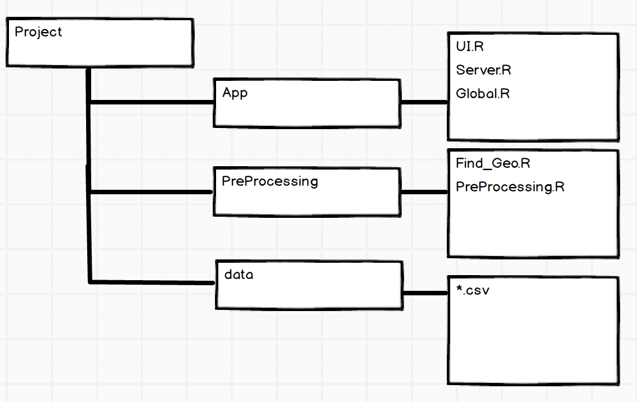
Project Structure
R Shiny Component
: Shiny Dashboard / ggplot / leaflet
Find_Geo.R
: Transform Geo lat/lot
PreProcessing.R
: Add New Feature / ETL / Missing Value

Slide 8
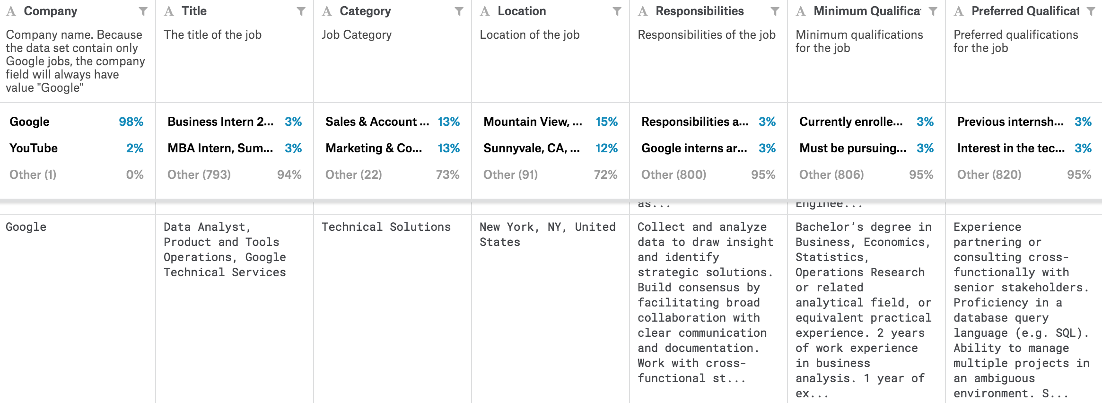
Make a extra feature – (1)
Preferred degree
Language
positions
City / Country
Experience

Slide 9
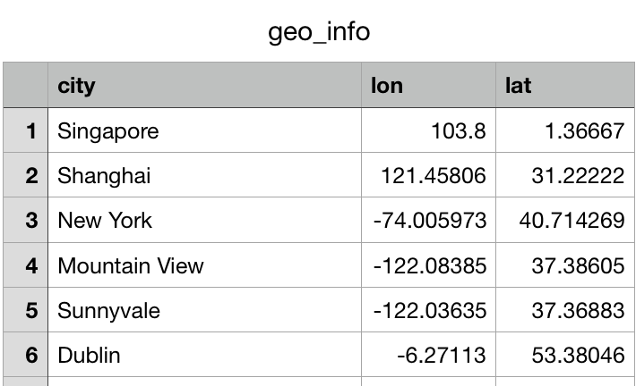
Make a extra feature – (2)
ggmap
City
Country
Latitude Longitude

Slide 10
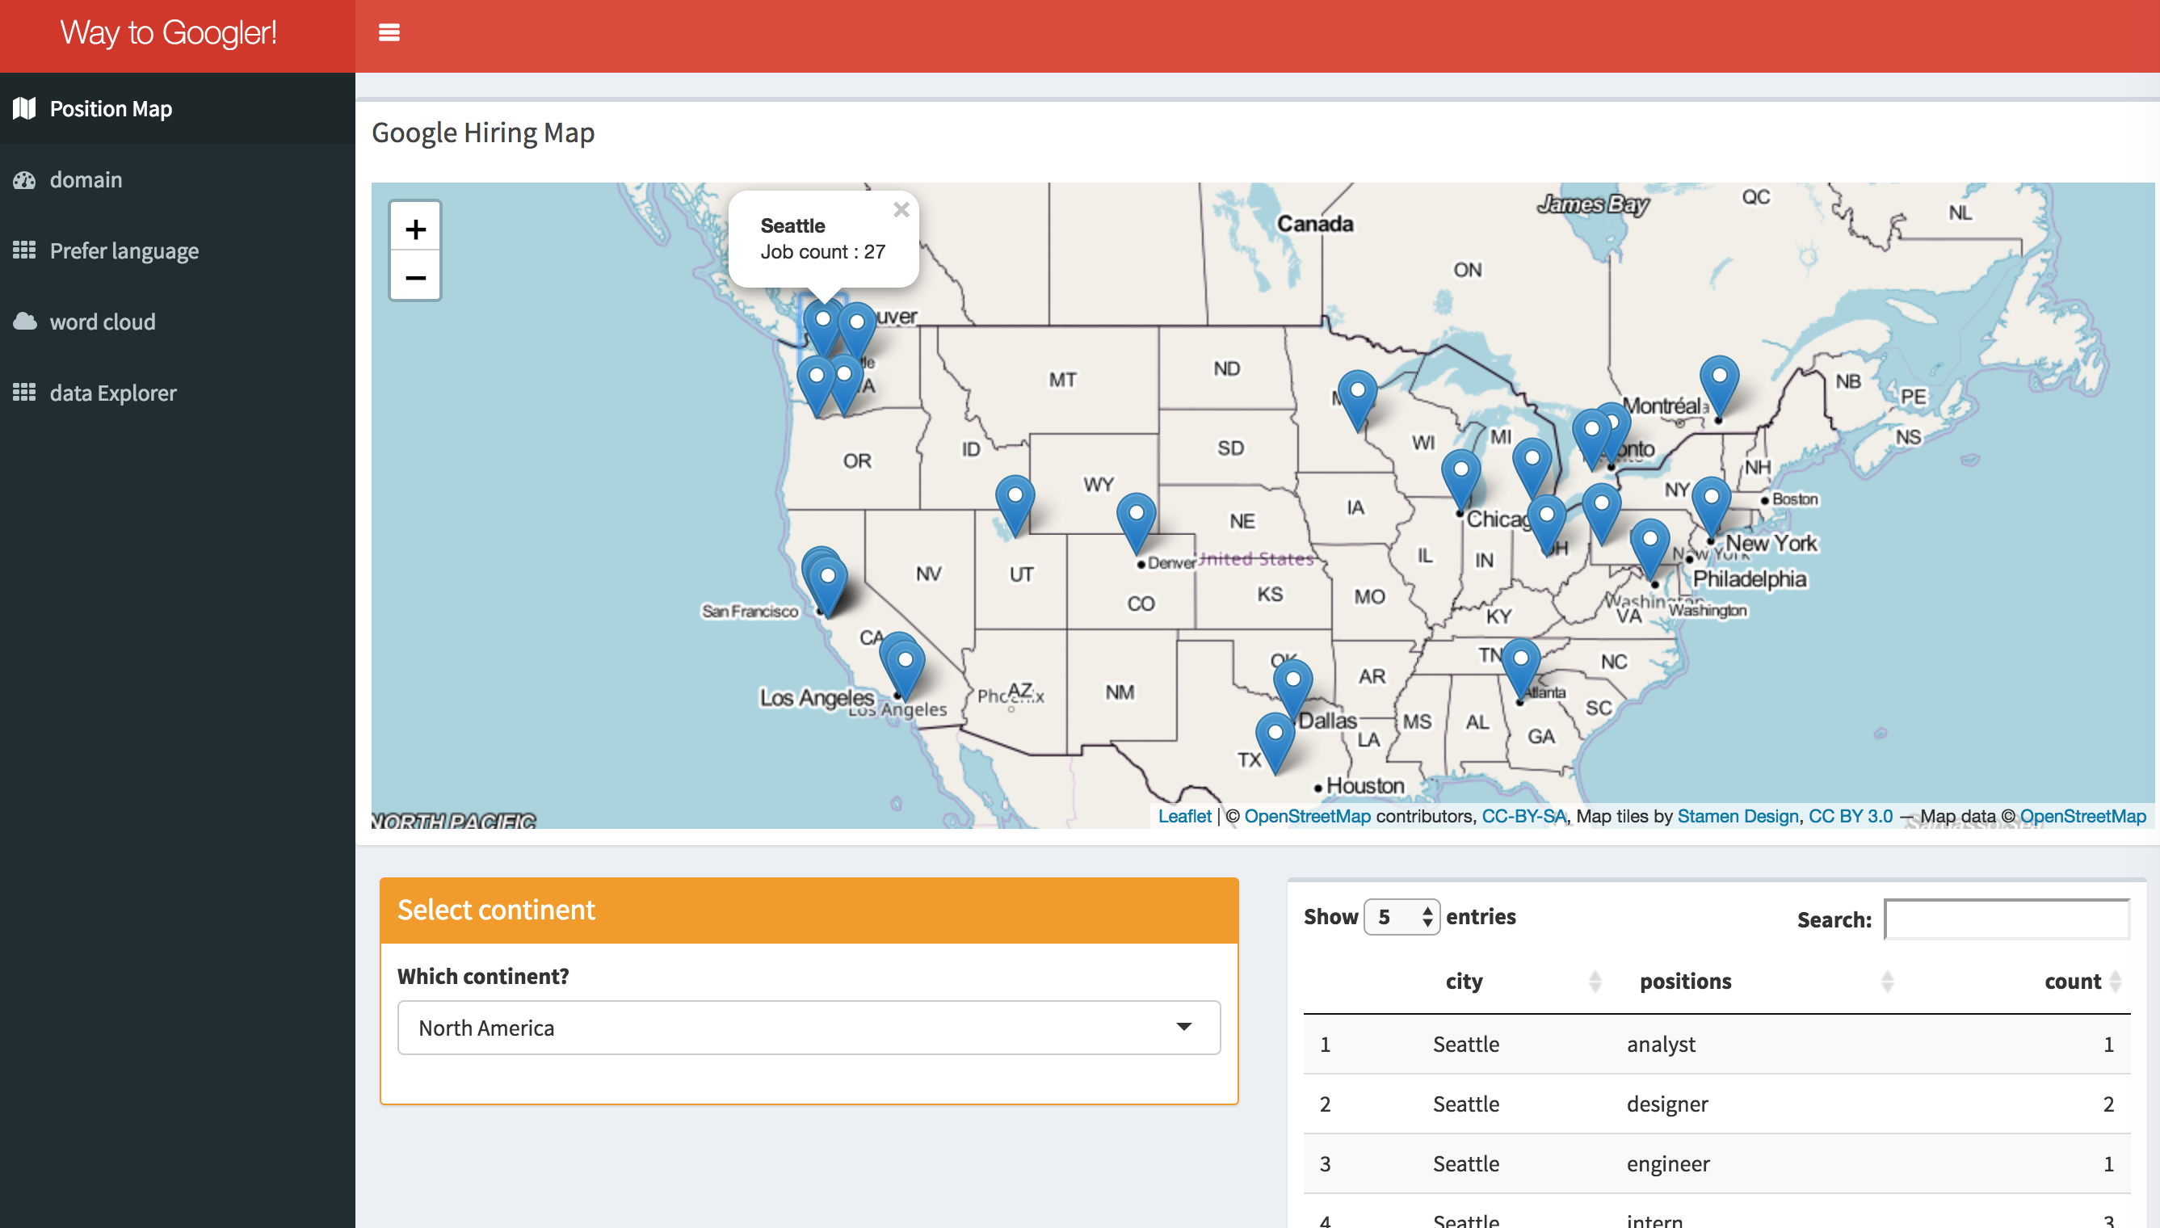
Shiny Application
https://hellotheresy.shinyapps.io/way_to_googler/

Slide 11
Position map – (1)

Slide 12
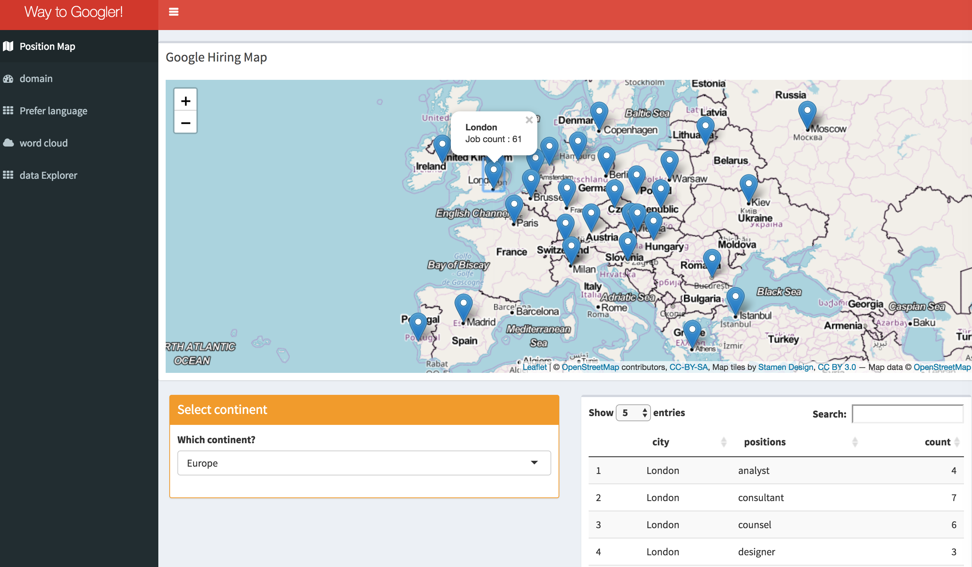
Position map – (2)

Slide 13
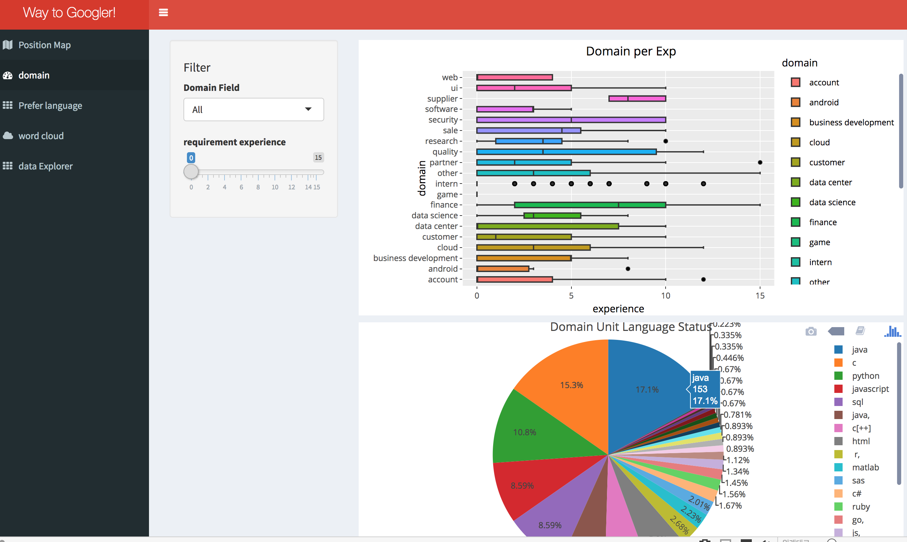
Domain – (1)

Slide 14
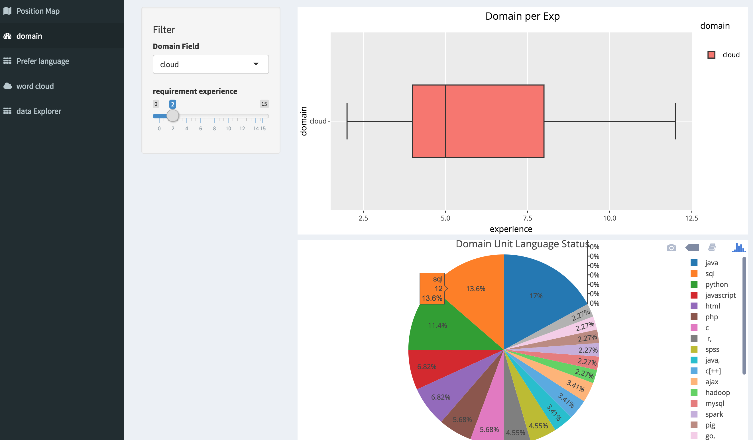
Domain – (2)

Slide 15
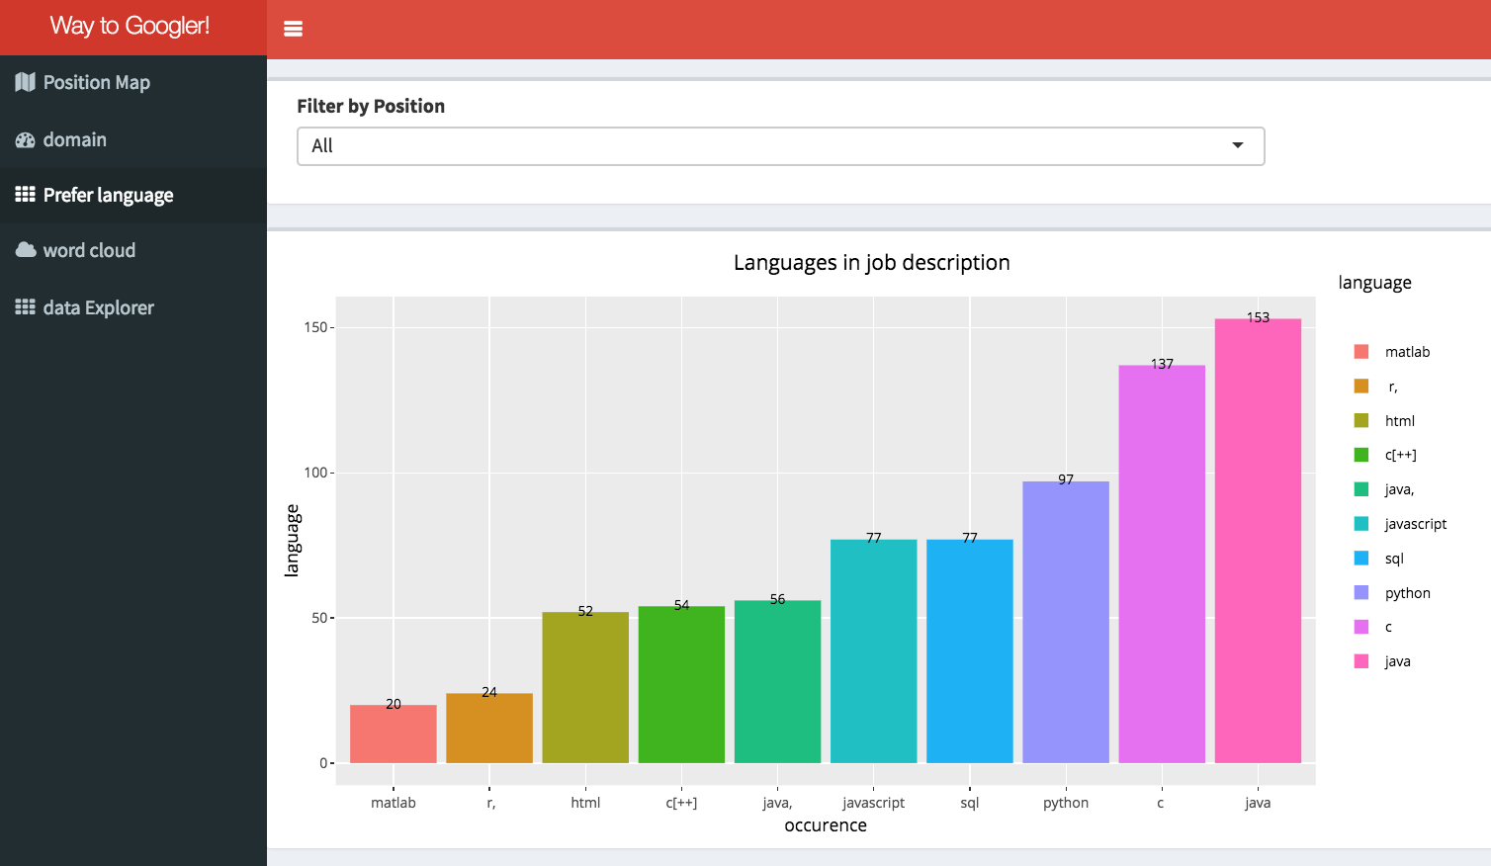
Prefer Language – (1)

Slide 16
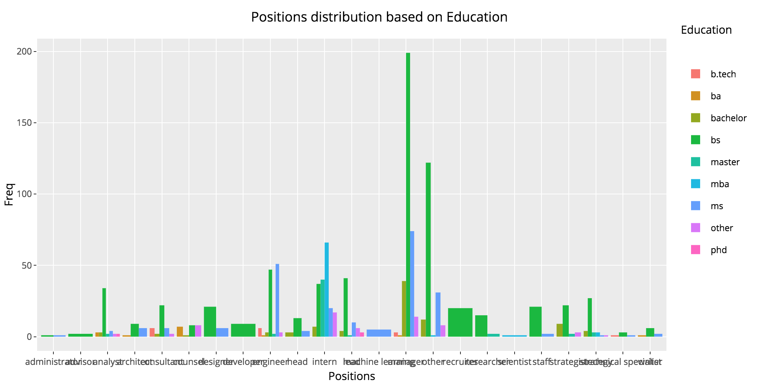
Prefer Language – (2)

Slide 17
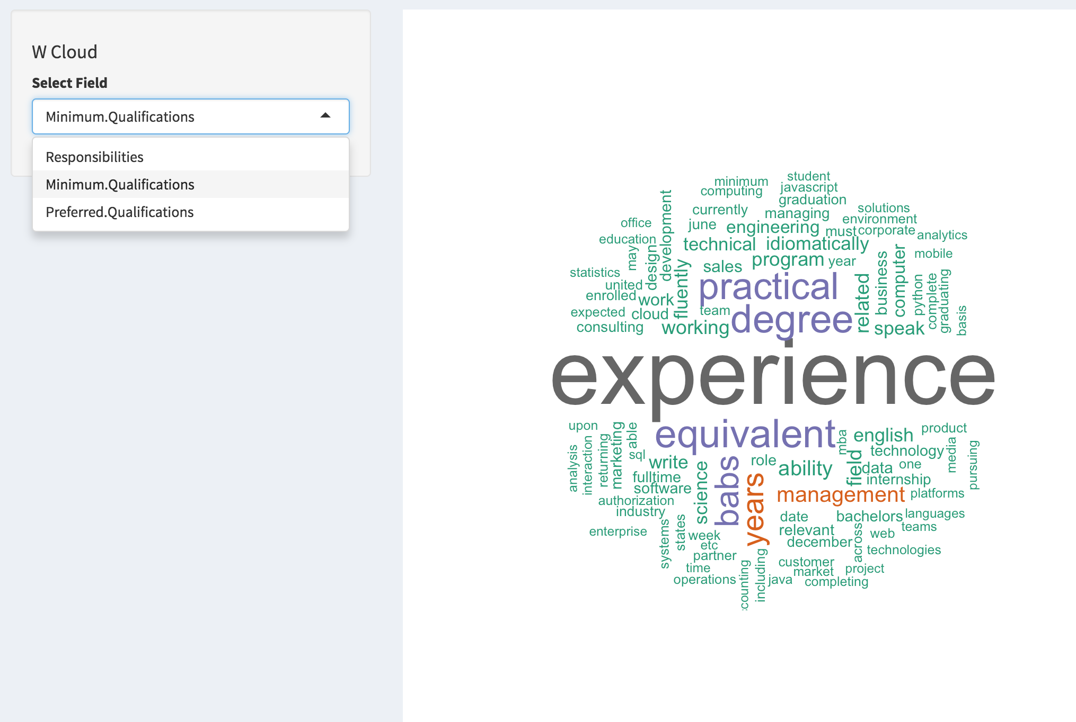
Word Cloud

Slide 18
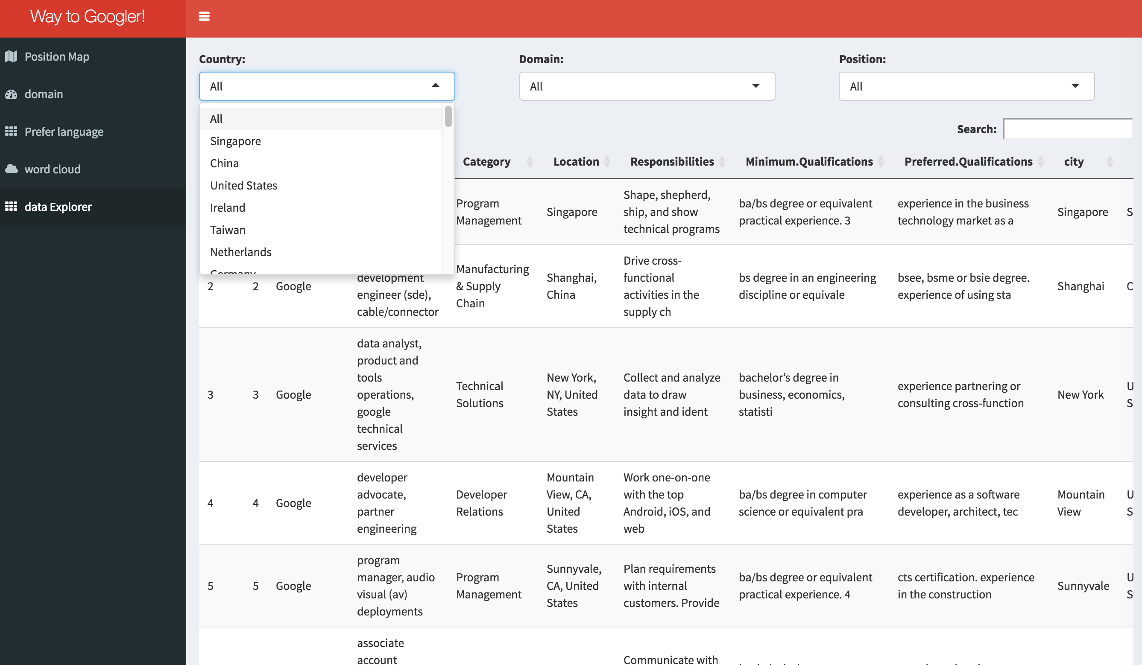
Data Explorer

Slide 19
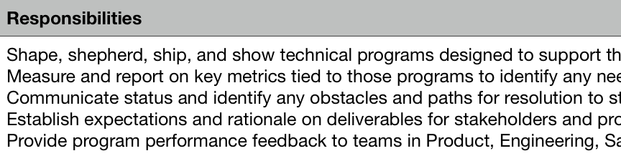
Conclusion & limitation
1. Time limitation was limitation
: homework .. Project .. Shiny..
2. UI (Web) development is difficult.
3. Description is a long sentence, so I couldn’t analyze properly.
: I just use simple word match

Slide 20
Conclusion & limitation
4. Shortage of Chart
: It was possible to analyze various combinations.
5. Absence of time series data
: If you check the size of position, domain, and language by increasing with time,
you might know the trend.

Slide 21
Thank you!

